Slide 1
Modern Expense Tracker
PRESENTED BY:
PRANVI PRAGYA SINGH

Slide 2
Objective / Problem Statement
- Track personal income and expenses efficiently
- Visualize financial status
- Search and filter transactions by category
- Provide real-time balance updates

Slide 3
Key Features
- Add, delete, and manage transactions
- Categorize transactions: Food, Shopping, Travel, Bills, Salary, Other
- Search transactions by text
- Filter transactions by category
- Calculate totals and balance
- Dark / Light theme

Slide 4
Technology Stack
- Frontend: HTML, CSS, JavaScript
- Storage: Browser localStorage
- Visualization: Chart.js (optional)
- Fully client-side, no backend

Slide 5
Folder Structure
ExpenseTracker/
├── index.html
├── style.css
├── js/
│ ├── app.js
│ ├── transaction.js
│ ├── ui.js
│ └── storage.js

Slide 6
Core Logic – Adding Transactions
- Validate inputs
- Create transaction object
- Push into array
- Save to localStorage
- Re-render UI

Slide 7
Core Logic – Calculating Totals
- Income = sum of positives
- Expense = sum of negatives
- Balance = income - expense
- Update DOM elements

Slide 8
Core Logic – Filtering & Searching
- getFilteredList(search, category)
- Filter by text
- Filter by category
- Dynamic updates

Slide 9
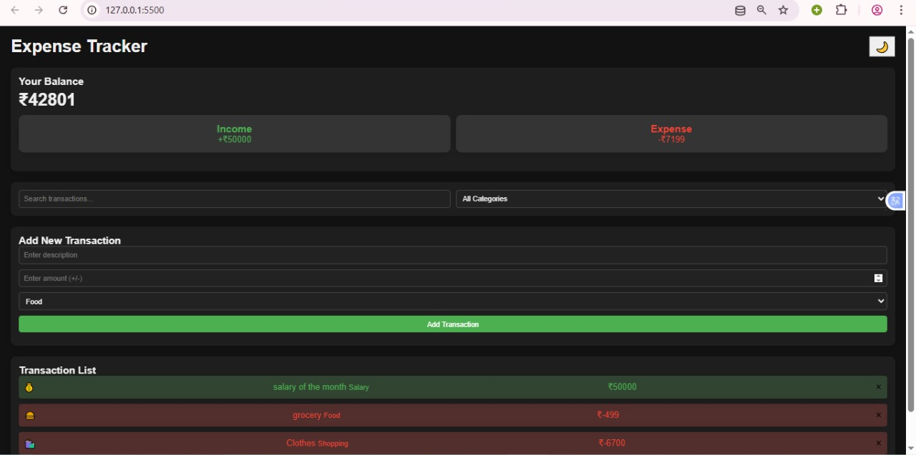
Screenshots / UI
Add your app screenshots here.

Slide 10
Future Improvements
- Cloud sync
- Recurring payments
- Export CSV
- Advanced charts
- Mobile UI

Slide 11
Thank You

